Slide 1

CAPSTONE PROJECT ON PIZZA RUNNER
By Thivya done on 19 june ,2022

Slide 2
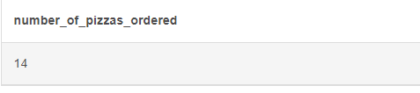
A. Pizza Metrics
How many pizzas were ordered?
select count(order_id) as number_of_pizzas_ordered from pizza_runner.customer_orders ;
Output:

Slide 3
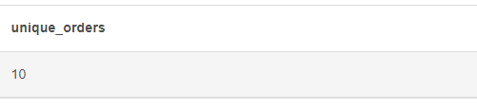
2.How many unique customer orders were made?
select count (distinct order_id) as Unique_orders from pizza_runner.customer_orders ;
output:

Slide 4
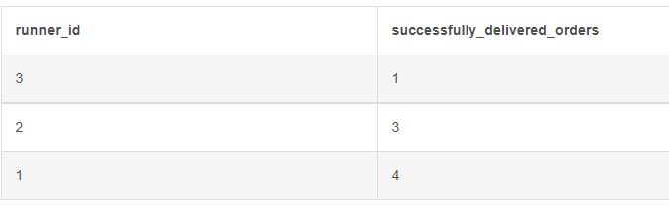
3.How many successful orders were delivered by each runner?
select runner_id,count (pickup_time) as successfully_delivered_orders from pizza_runner.runner_orders where pickup_time != 'null‘ group by 1 ;
Output:

Slide 5
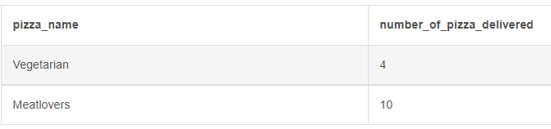
4.How many of each type of pizza was delivered?
select p.pizza_name,count(c.pizza_id) as number_of_pizza_delivered
from pizza_runner.customer_orders c
join pizza_runner.pizza_names p
on c.pizza_id=p.pizza_id
group by 1 order by 2
Output:

Slide 6
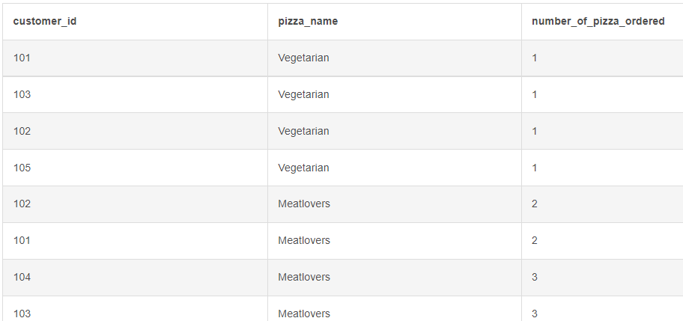
5. How many Vegetarian and Meatlovers were ordered by each customer?
select c.customer_id,p.pizza_name,count(c.pizza_id) as number_of_pizza_ordered
from pizza_runner.customer_orders c
join pizza_runner.pizza_names p
on c.pizza_id=p.pizza_id
group by 1,2 order by 3

Slide 7
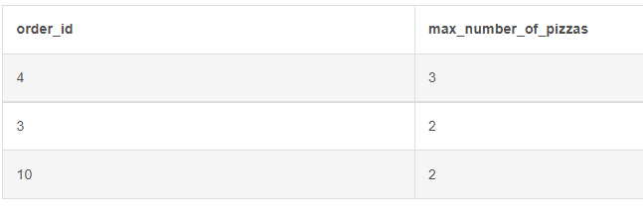
6. What was the maximum number of pizzas delivered in a single order?
select order_id,count(pizza_id) as max_number_of_pizzas
from pizza_runner.customer_orders
group by 1
order by 2 desc
limit 3

Slide 8
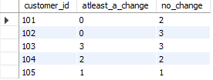
7. For each customer, how many delivered pizzas had at least 1 change and how many had no changes?
select c.customer_id, sum(case when (exclusions !=0 and exclusions is not null) or (extras is not null and extras !=0) then 1 else 0 end ) as atleast_a_change, sum(case when (exclusions =0 or exclusions is null) or (extras is null or extras =0) then 1 else 0 end ) as no_change from customer_orders c join runner_orders1 r on c.order_id=r.order_id where distance!=0 group by 1

Slide 9
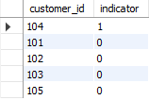
8. How many pizzas were delivered that had both exclusions and extras?
select customer_id ,sum(case when (exclusions is not null and exclusions != 0) and (extras is not null and extras!=0) then 1 else 0 end) as indicatorfrom customer_orders cjoin runner_orders1 ron r.order_id = c.order_idwhere distance!=0group by 1 order by 2 desc

Slide 10
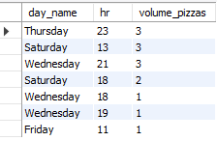
9. What was the total volume of pizzas ordered for each hour of the day?
select dayname(order_time) as day_name,extract(hour from order_time) as hr,count(order_id) as volume_pizzas from customer_orders1 group by 1,2 order by 3 desc

Slide 11

10. What was the volume of orders for each day of the week?
select dayname(order_time) as day_name,count(order_id) as volume_pizzas from customer_orders1 group by 1 order by 2

Slide 12

B. Runner and Customer Experience How many runners signed up for each 1 week period? (i.e. week starts 2021-01-01)
SELECT week(registration_date) AS registration_week,
COUNT(runner_id) AS runner_signup
FROM pizza_runner.runners
GROUP BY 1
order by 1;
Alternate:
select extract(week from registration_date) as week,count(runner_id) as signed_runners from runners group by 1

Slide 13

2. What was the average time in minutes it took for each runner to arrive at the Pizza Runner HQ to pickup the order?
select r.runner_id, floor(avg(timestampdiff(minute,c.order_time,r.pickup_time))) as avg_time_interval from customer_orders c join runner_orders r on c.order_id=r.order_id group by 1

Slide 14
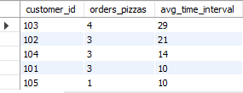
3.Is there any relationship between the number of pizzas and how long the order takes to prepare?
select c.customer_id,count(c.order_id) as orders_pizzas, ceiling(avg(timestampdiff(minute,c.order_time,r.pickup_time))) as avg_time_interval from customer_orders c join runner_orders r on c.order_id=r.order_id group by 1 order by 3 desc

Slide 15
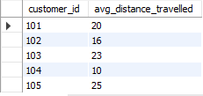
4. What was the average distance travelled for each customer?
select c.customer_id, floor(avg(distance)) as avg_distance_travelled from customer_orders c join runner_orders r on c.order_id=r.order_id where distance!=0 group by 1

Slide 16

5. What was the difference between the longest and shortest delivery times for all orders?
select(max(time_interval)-min(time_interval)) as diference from(select r.order_id, floor(timestampdiff(minute,c.order_time,r.pickup_time)) as time_interval from customer_orders c join runner_orders1 r on c.order_id=r.order_id) sub

Slide 17
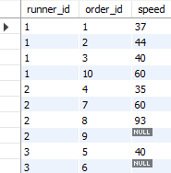
6. What was the average speed for each runner for each delivery and do you notice any trend for these values?
select r.runner_id,
r.order_id,
floor((distance)/(duration/60)) as speed from runner_orders1
group by 1,2
order by 1

Slide 18

7. What is the successful delivery percentage for each runner?
with cte as(select runner_id, count(order_id) as num_succesfull_orders from runner_orders1where distance!=0group by 1),cte1 as(select runner_id,count(order_id) as num_orders from runner_orders1 group by 1) select B.runner_id ,round((num_succesfull_orders/num_orders )*100,0) as percentage from cte A join cte1 B on A.runner_id=B.runner_id group by 1

Slide 19
C. Ingredient Optimization
1.What are the standard ingredients for each pizza?
select pizza_name,group_concat(topping_name) from ( select pizza_name,r.pizza_id,topping_name from pizza_names n join pizza_recipes1 r on n.pizza_id=r.pizza_id join pizza_toppings t on t.topping_id=r.toppings order by 2 ) A group by 1

Slide 20

D. Pricing and Ratings
1.If a Meat Lovers pizza costs $12 and Vegetarian costs $10 and there were no charges for changes - how much money has Pizza Runner made so far if there are no delivery fees? select runner_id,sum(case when pizza_id=1 then 12 when pizza_id=2 then 10 else null end ) as cost from customer_orders c join runner_orders r on c.order_id=r.order_id where distance!=0 group by 1
Total $138 were made by the runners so far.

Slide 21

2.If a Meat Lovers pizza was $12 and Vegetarian $10 fixed prices with no cost for extras and each runner is paid $0.30 per kilometre traveled — how much money does Pizza Runner have left over after these deliveries?
with totalamountearned as( select sum(case when pizza_id=1 then 12 when pizza_id=2 then 10 else null end ) as cost from customer_orders c join runner_orders1 r on c.order_id=r.order_id where distance!=0 ) set @totalamountamountearned = 138;
select @totalamountearned - (sum(distance))*0.3 as leftover_travelling_chargesfrom runner_orders1;

Slide 22


